Slide 1

Building an R-centered Reproducible Research Framework
Charles Tilford, Ph.D.
Translational Bioinformatics
Cambridge, MA

Slide 2
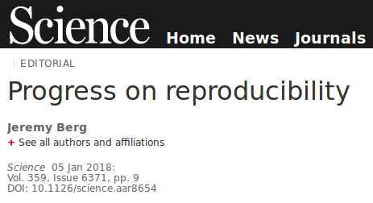
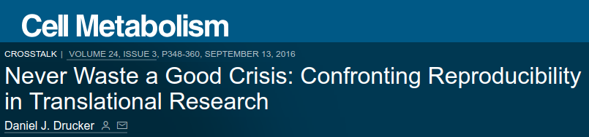
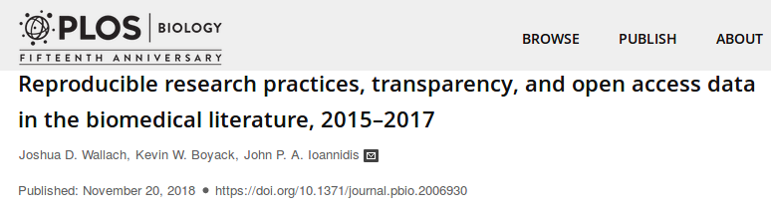

The (Recognition of the) Reproducibility Crisis is Upon Us

Slide 3

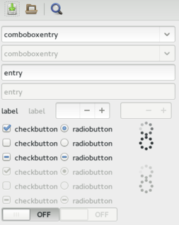
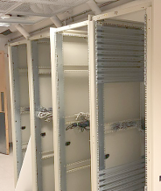
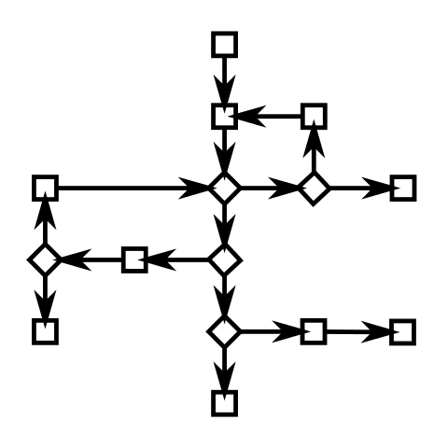






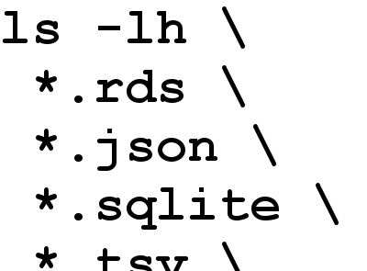






Addressing Reproducible Challenges
Missing Files | Untracked GUI Interactions | Retired Hardware | Untracked Modifications | Absent Services | Researcher Turnover
Immutable Storage | Full Scripting | Virtualization | Version Control | Extensive Serialization | Documentation

Slide 4


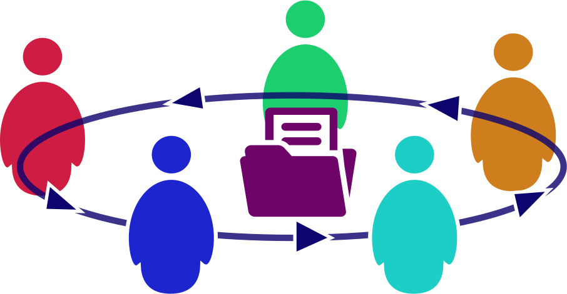


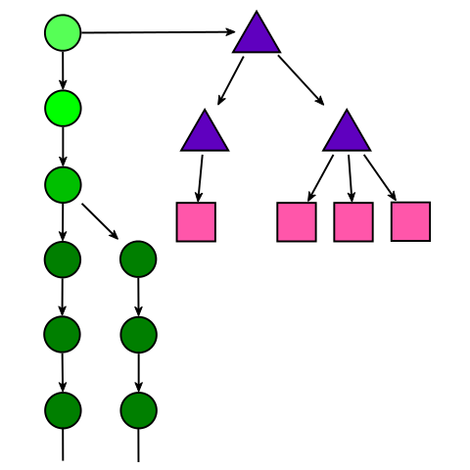
Successes & Lessons
Fully Adopted by Team of 50+, Still Evolving | Culture is Critical | Standards Enhance Collaboration
Shared Code Accelerates Research | Complete Traceability on all Analyses | More Info on GitHub
Q2
Q3
Q4
maptracker/EARL-2018

